Slide 1
Vehicle Number Plate Detection Using Raspberry Pi UNDER THE GUIDANCE OF Ms. Preety Singh PRESENTED BY K. Shashi Kiran R. Sanath Kumar Ch. Sruthi S. Sai Karun

Slide 2
INDEX
Introduction
Objective
Literature survey
Proposed system
Advantages
Disadvantages
Hardware requirements
Software requirements
Applications
Conclusion and future scope

Slide 3
INTRODUCTION
Number plate recognition is an effective way for automatic vehicle identification.
Some of the existing algorithms based on the principle of learning takes a lot of time and expertise before delivering satisfactory results but even then lacks in accuracy.
In the proposed algorithm an efficient method for recognition for Indian vehicle number plates has been devised.
The algorithm aims at addressing the problems of scaling and recognition of position of characters with a good accuracy rate of 98.07%.

Slide 4
OBJECTIVE
For an important method of car control, we require an system for vehicle number plate recognition.
This system will provide monitoring vehicles for law enforcement and security purposes, and keeping track of vehicles by successful recognition of plate number.
It may be used in places such as border control and Automatic Toll tax collection.

Slide 5
LITERATURE SURVEY
In the literature, many license plate detection algorithms have been proposed.
Although license plate detection has been studied for many years, it is still a challenging task to detect license plates from different angles, partial occlusion, or multiple instances.
Since a plate can exist anywhere in an image with various sizes, it is infeasible to check every pixel to locate it.

Slide 6
LITERATURE SURVEY(contd..)
Generally, it is preferable to extract some features from images and focus only on those pixels characterized by the license plate.
License plate is characterized by a rectangular shape with a specific aspect ratio, and can be extracted by checking all possible rectangles in the image kinds of traditional locating methods.
Some other approaches based on local features have also been proposed recently.

Slide 7
PROPOSED SYSTEM
Here we propose a Raspberry Pi based vehicle number plate recognition system that automatically recognizes vehicle number plates using image processing.
The system uses a camera along with LCD display circuit interfaced to a Raspberry pi.
The system constantly processes incoming camera footage to detect any trace of number plates.

Slide 8
PROPOSED SYSTEM(contd..)
On sensing a number plate in front of the camera, it processes the camera input, extracts the number plate part from the image.
Processes the extracted image using OCR and extracts the number plate number from it.
The system then displays the extracted number on an LCD display.

Slide 9
ADVANTAGES
To Reduce Crime and the Fear of Crime.
Reduce Burglaries
Reduce Vehicle Crime.
Reduce shop theft , Reduce damage .
Reduce motorcycle / traffic related nuisance.

Slide 10
DISADVANTAGES
Firstly, the images of the number plate or of any object which is taken by using the optical character reader technology may get blurred mainly due to the reason of motion blurring for which the picture seems to be hazy when uploaded in the database.
Secondly, the technology often uses low-resolution images for which the images are not actually visible properly in every case.

Slide 11
APPLICATIONS
Traffic signals.
Border crossings.
Automobile repossessions.
recognize customers based on their license plate.

Slide 12
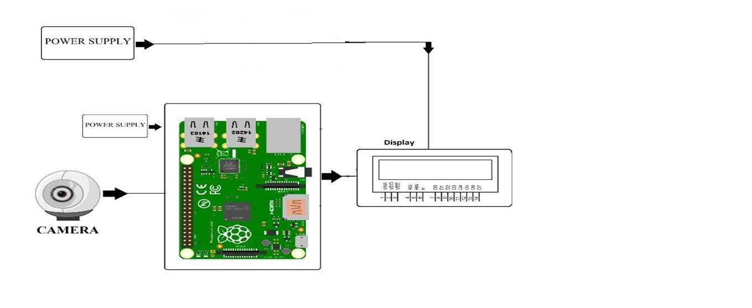
DESIGN
Block Diagram:

Slide 13
HARDWARE REQUIREMENTS
Raspberry pi
Power supply for RPI
SD card
HDMI to VGA cable
Bread boards
Connecting wires
PCB
Logitech camera
LCD

Slide 14
SOFTWARE REQUIREMENTS
Raspbian OS
Programming Language: Python

Slide 15
EMBEDDED SYSTEMS USED
The entire process of VNPR is hinged on the very basis of a singular Embedded System –the CAMERA.
The Camera must take the most OPTIMIZED picture of the License rather than just a normal picture.

Slide 16
CAMERA
The camera, triggered by the IR sensor, captures the image of the approaching vehicle and after further processing of the vehicle using image processing information of the vehicle such as number plate is displayed in the LCD using Vehicle Number Plate Detection System.

Slide 17
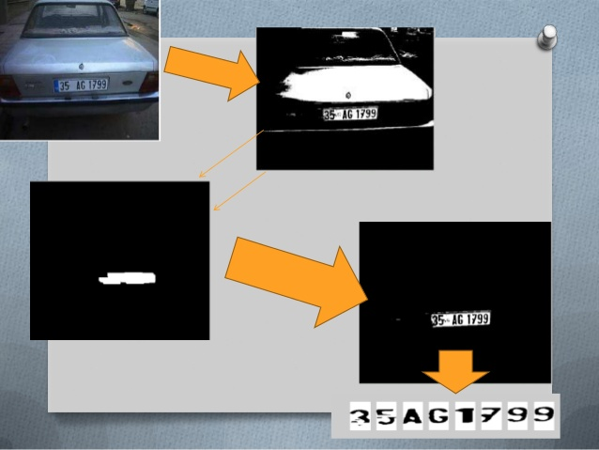

Slide 18
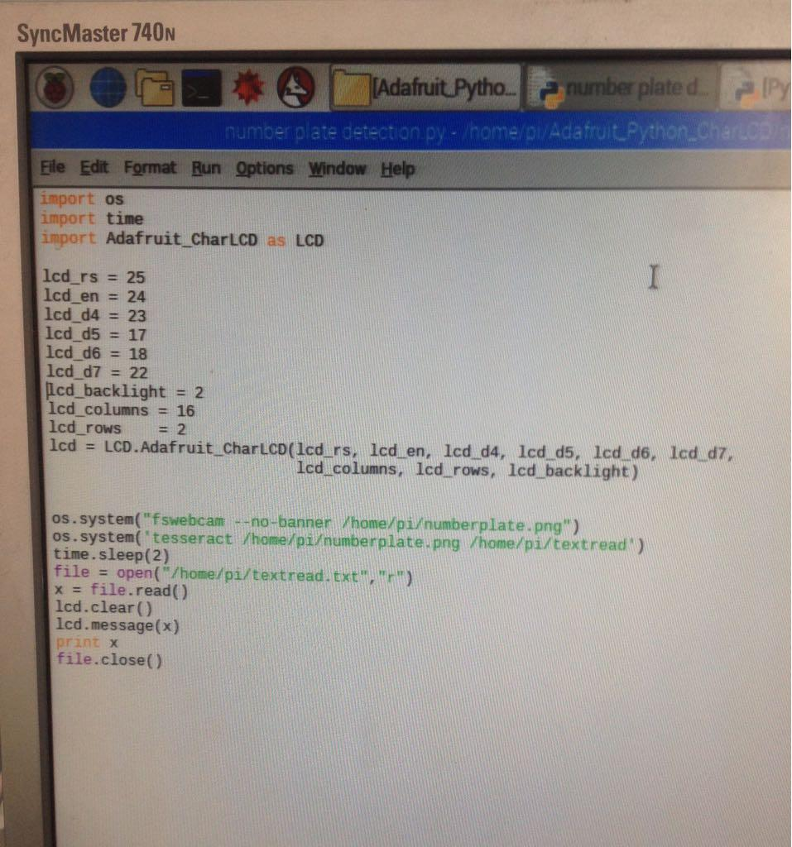
CODE

Slide 19
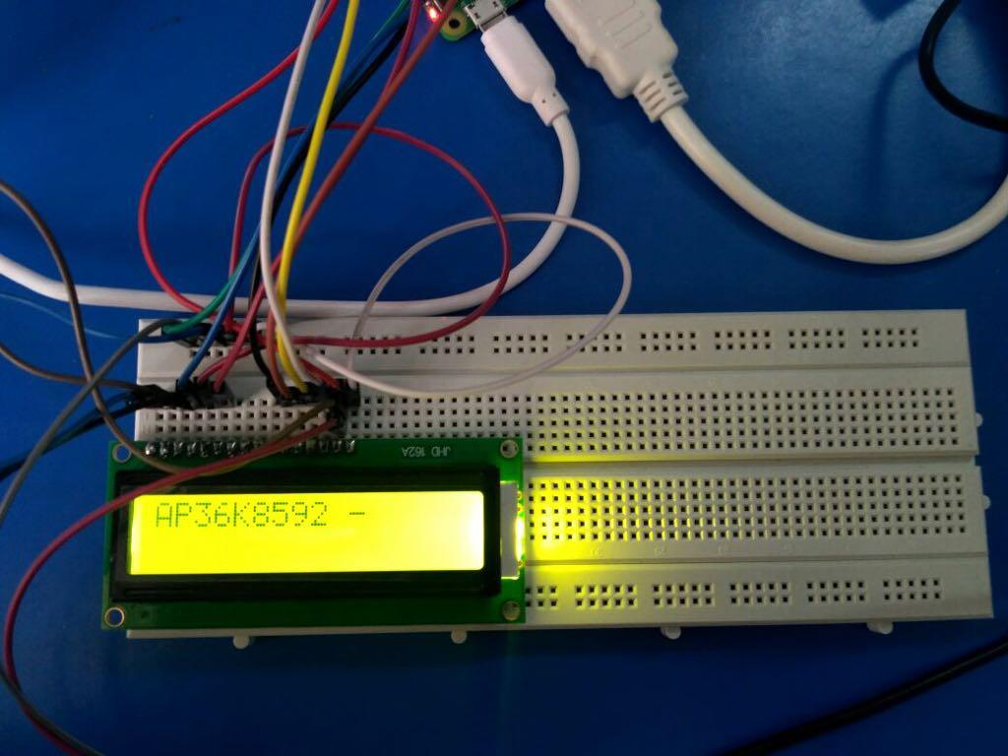
OUTPUT

Slide 20
CONCLUSION AND FUTURE SCOPE
The vehicle number plate detection system plays an important role in detecting security threat.
The system use series of image processing techniques for identifying the vehicle from the database stored in the PC
The system is implemented in Raspberry pi and it performance is tested on real images.

